Slide 1
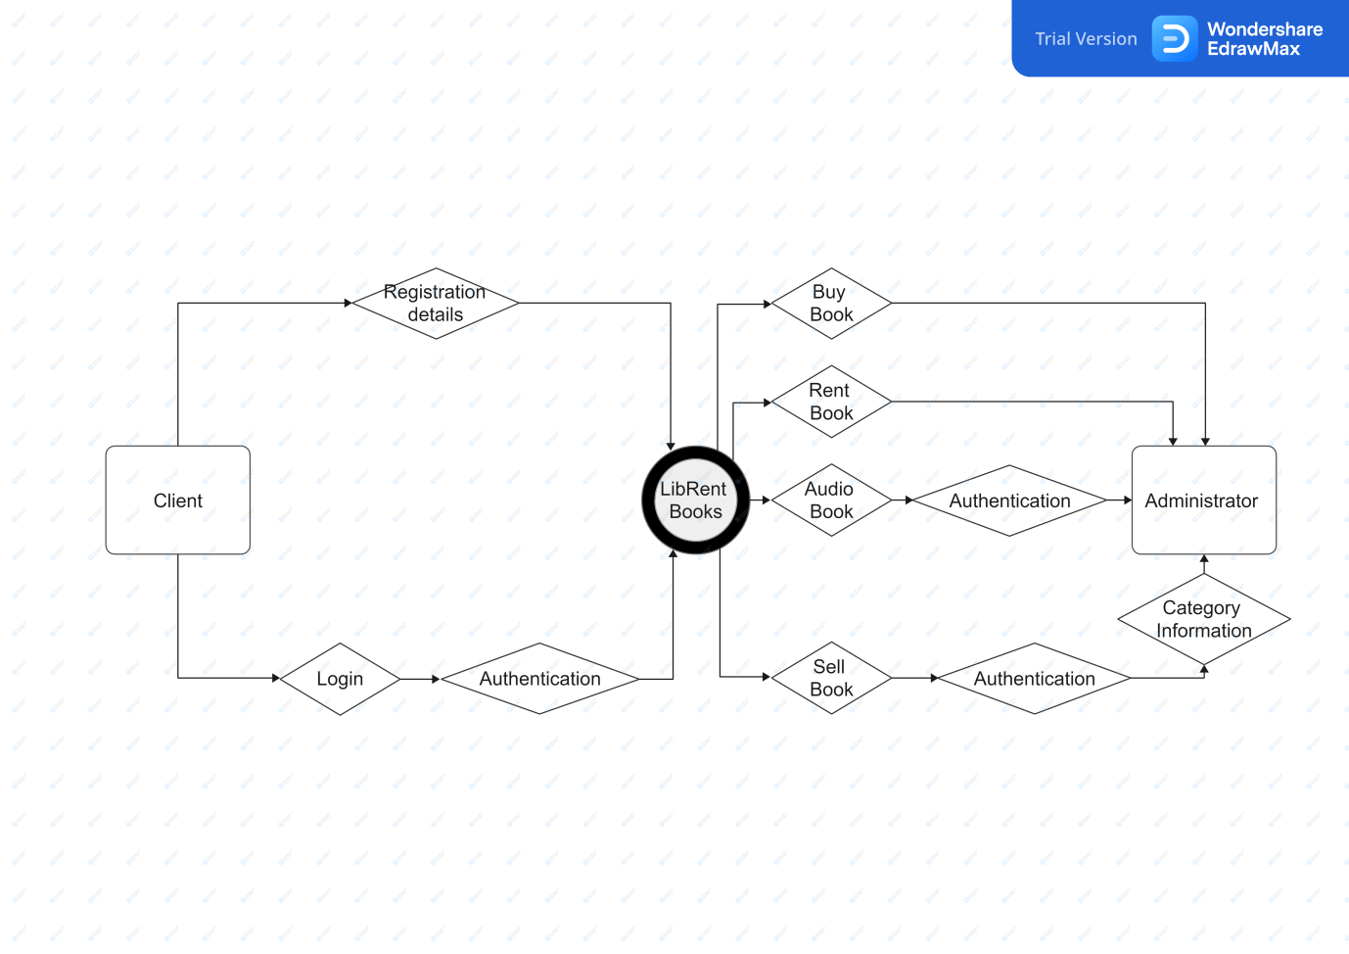
Data Flow Diagram(DFD)

Slide 2
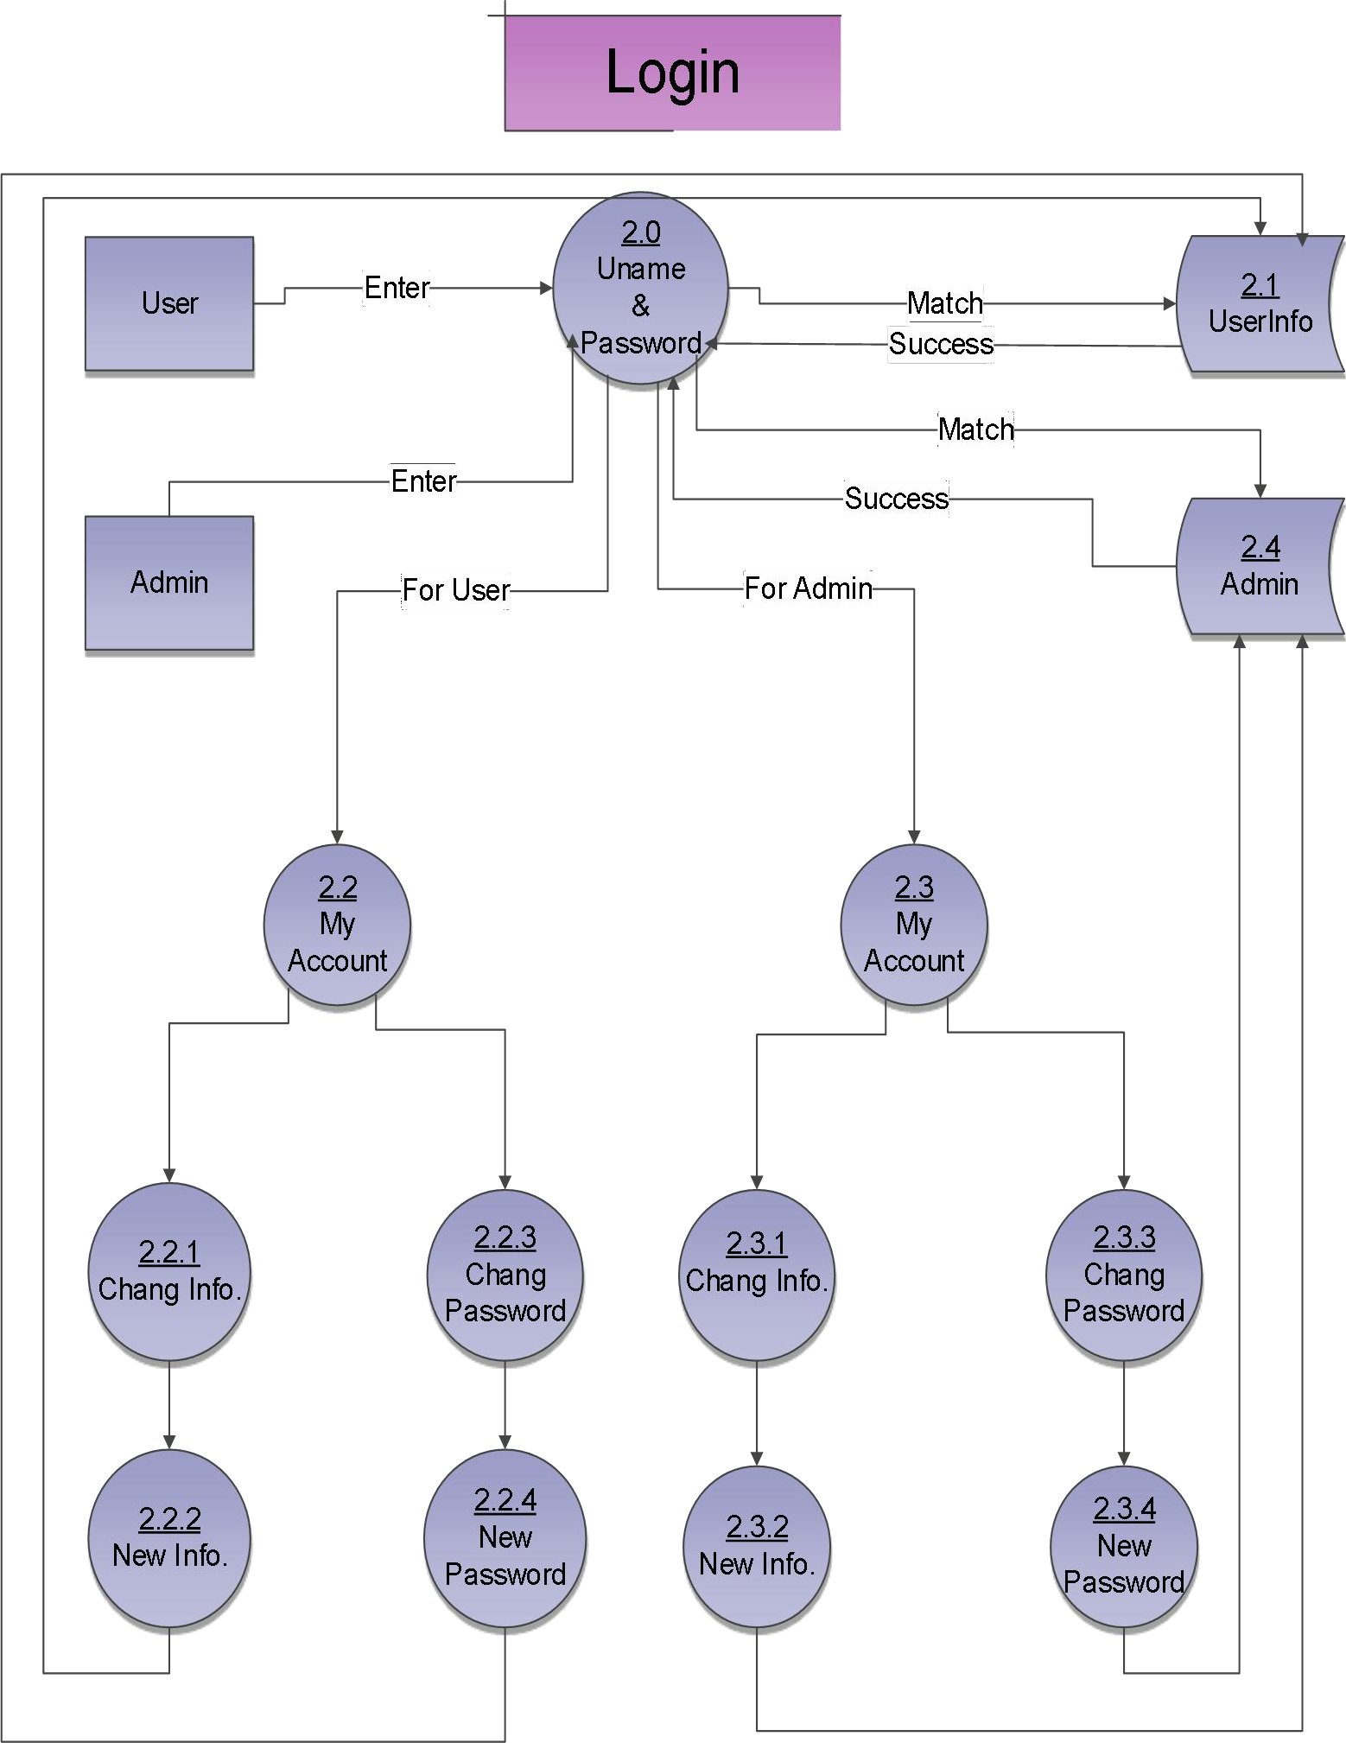
Login

Slide 3
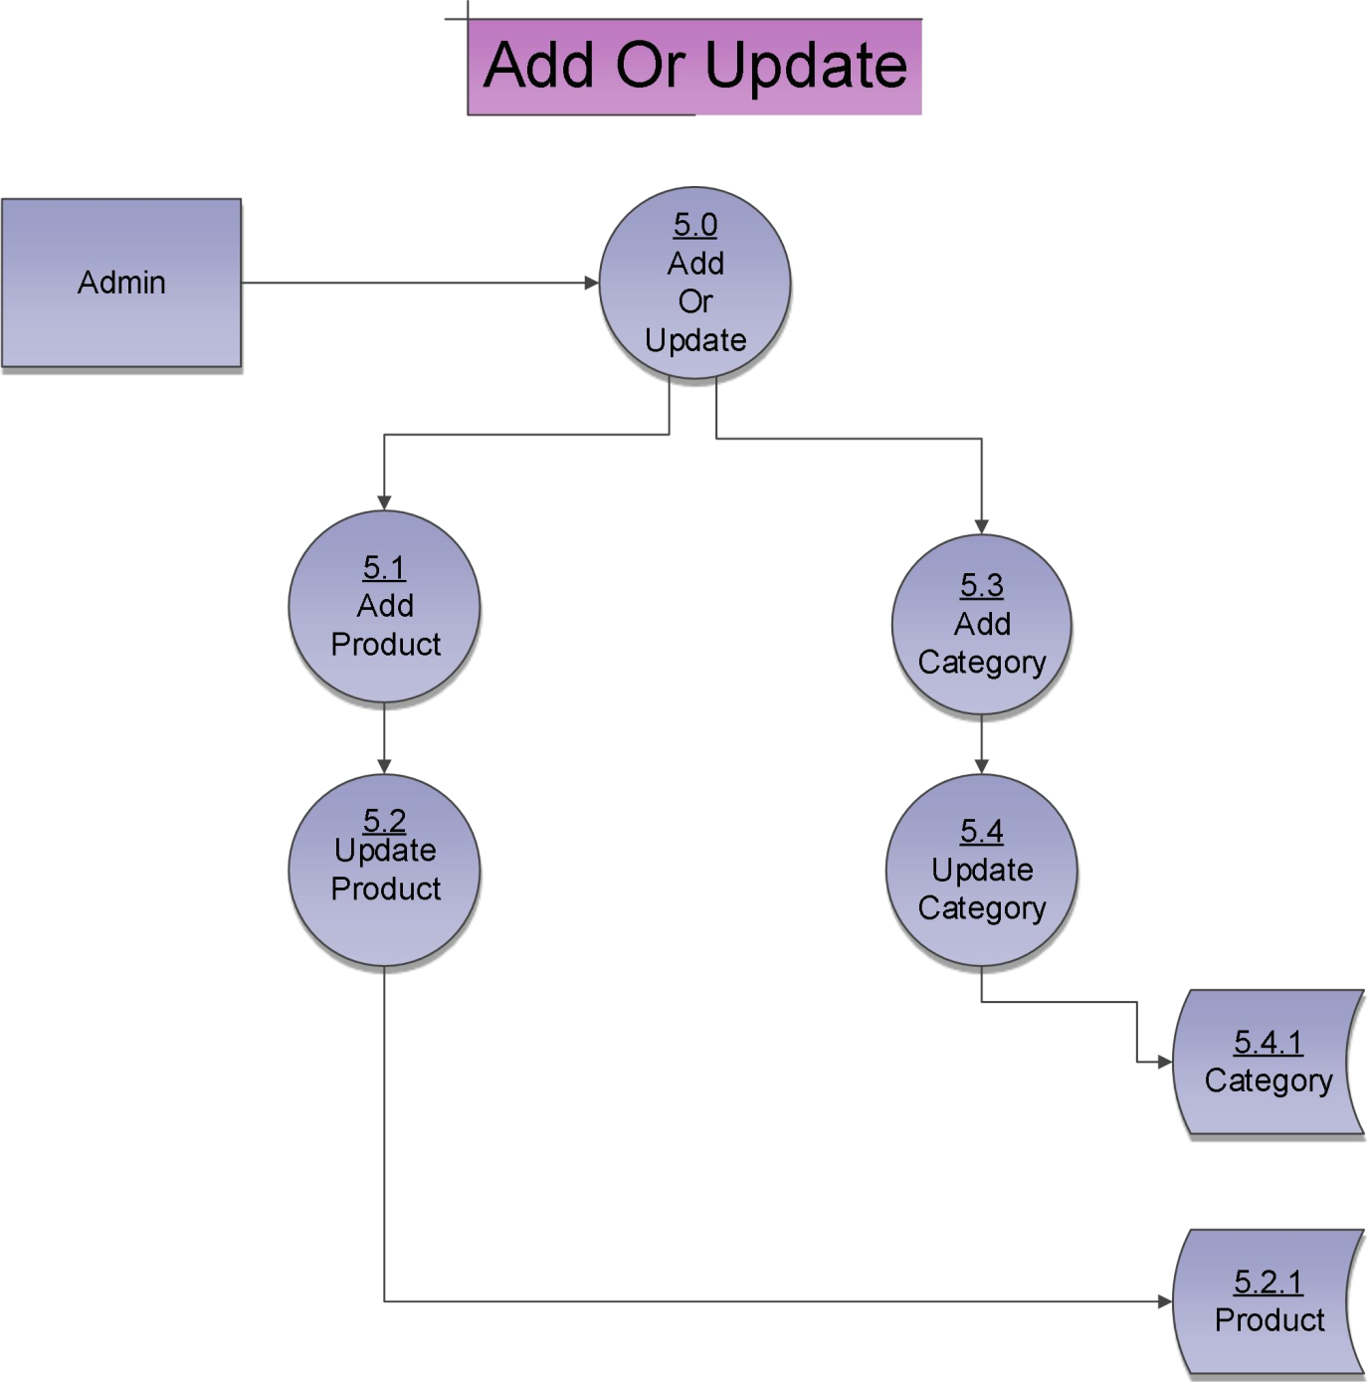
Add Or Update Books

Slide 4
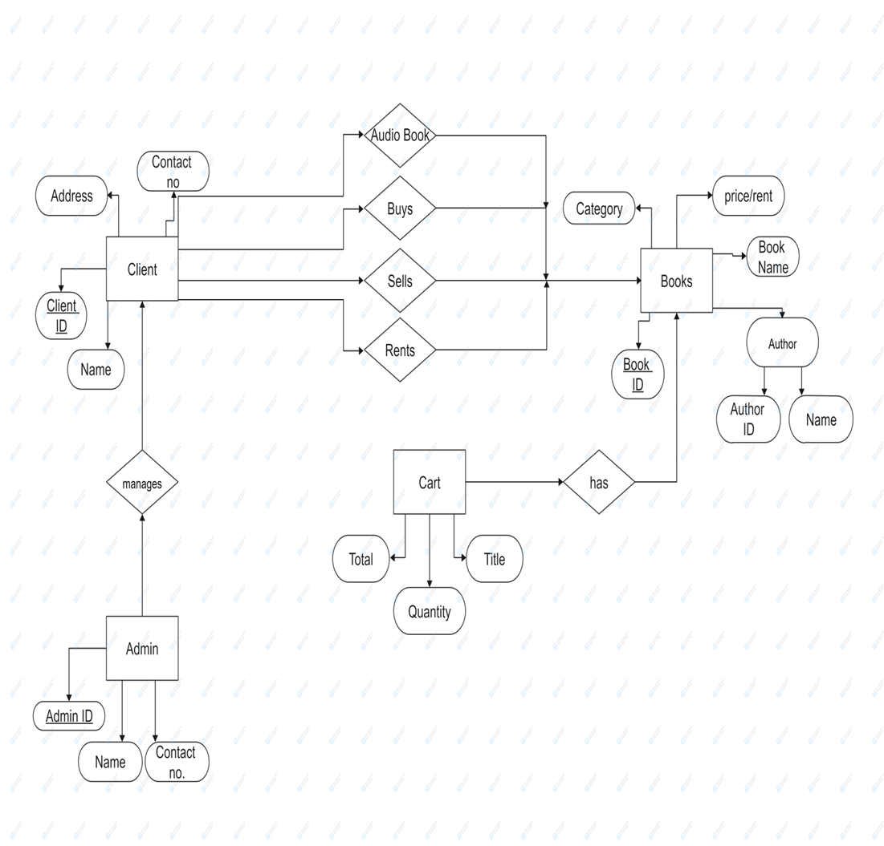
E-R Diagram

Slide 5
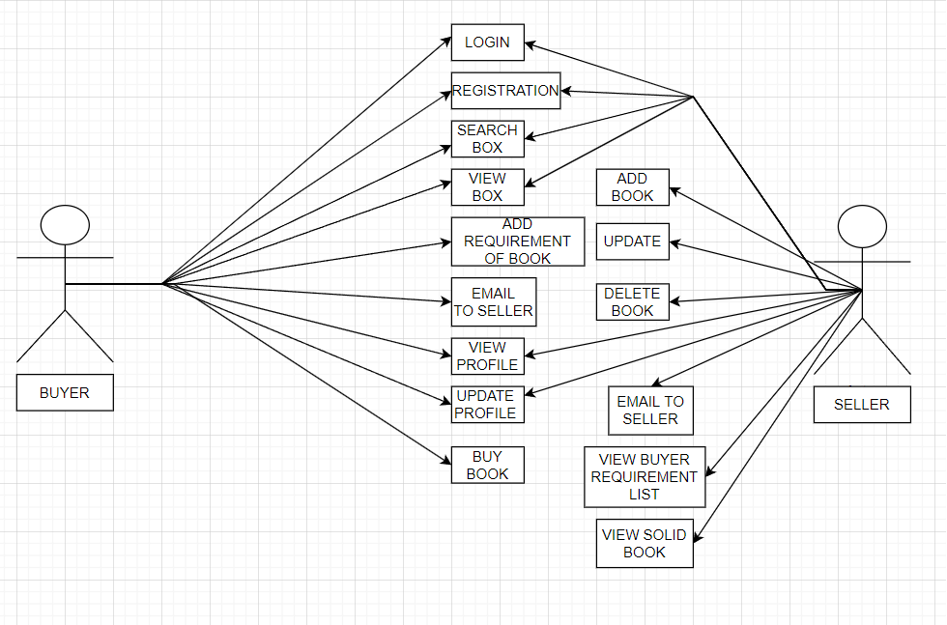
Use Case Diagram(User)

Slide 6
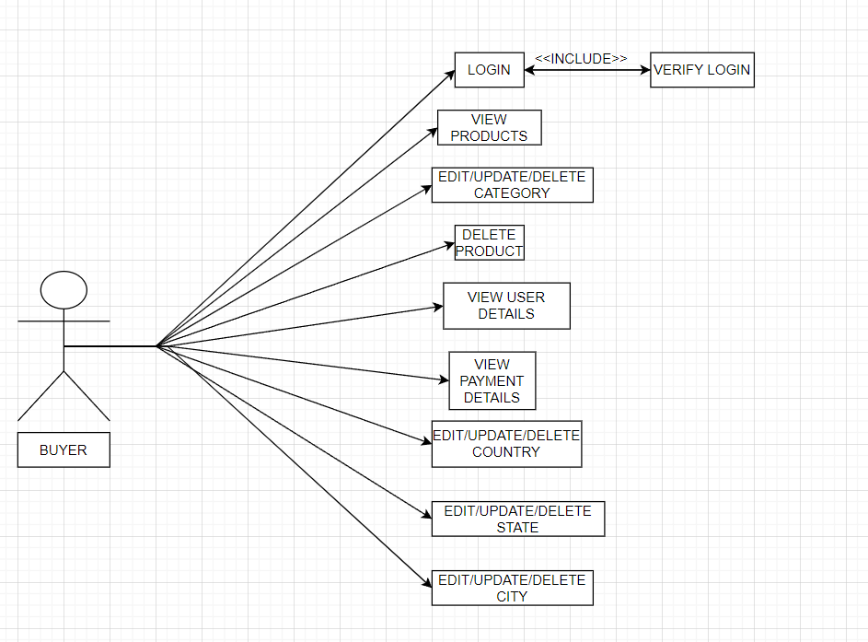
Use Case Diagram(Buyer)

